Slide 1
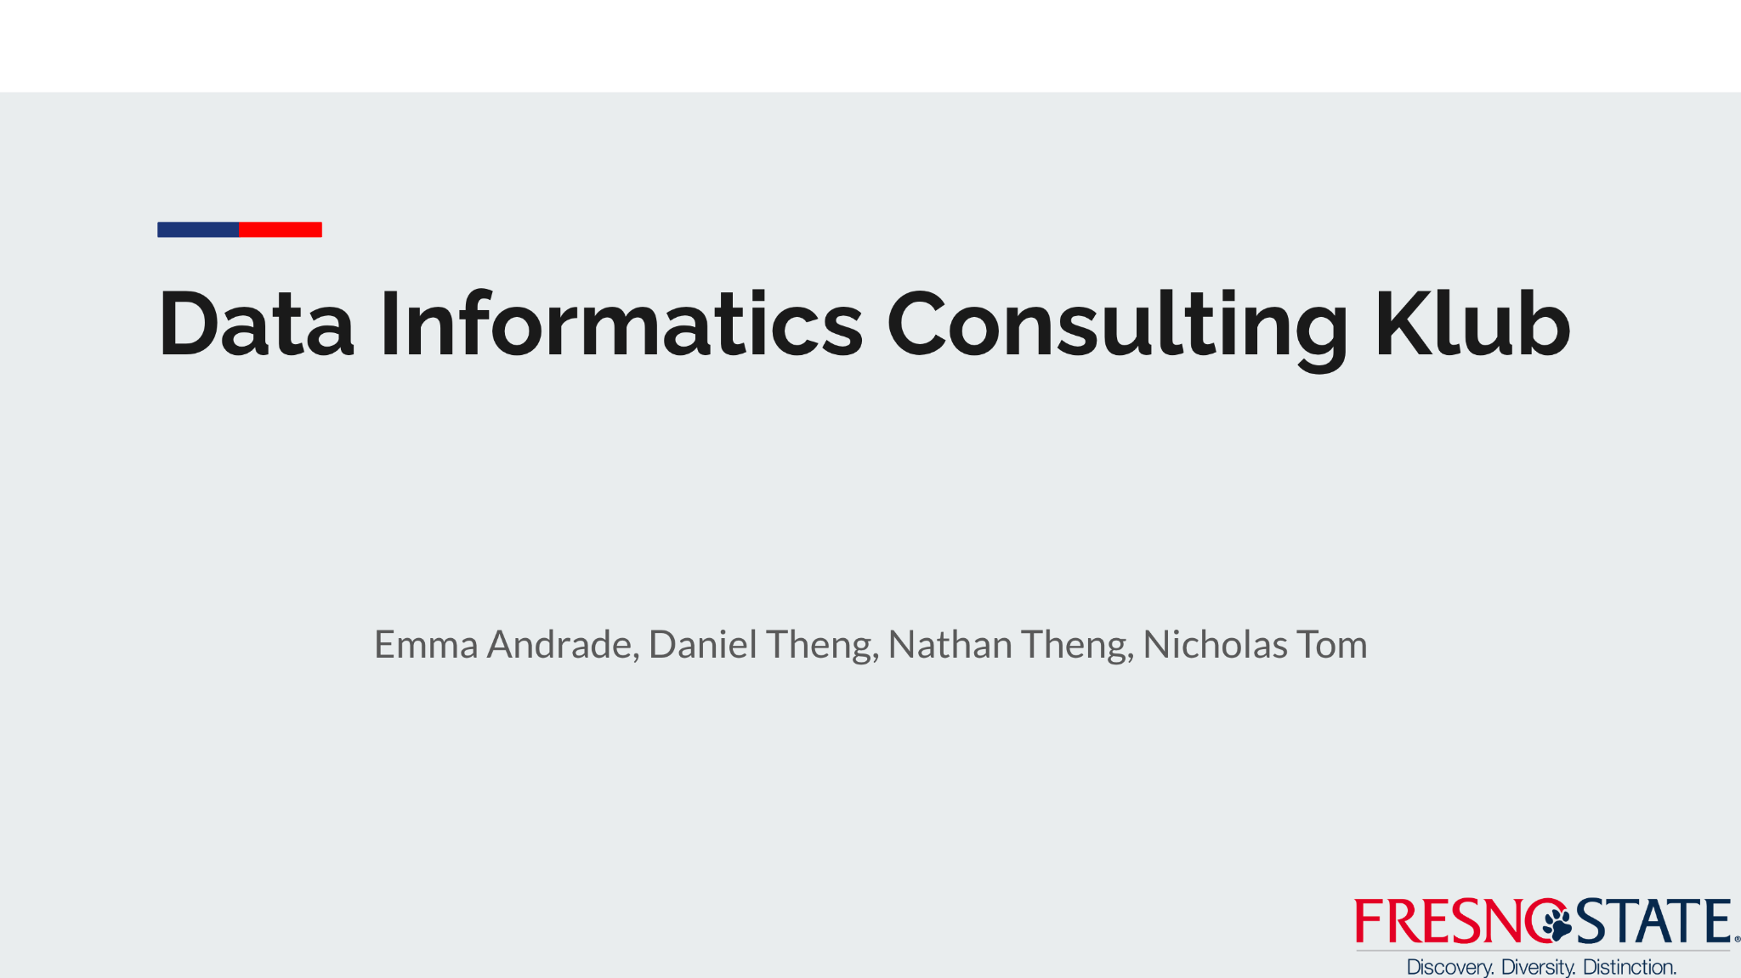
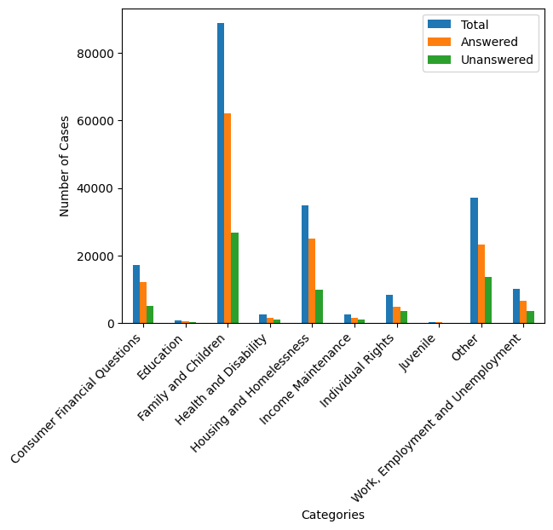
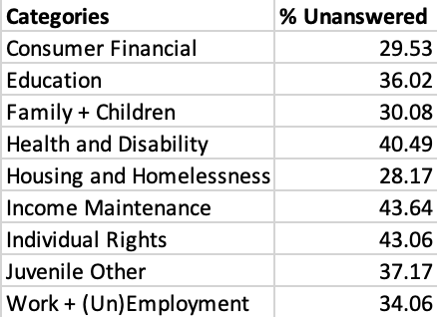

Data Visualization
Research Question: Given any question, which attorneys are most suited to take the case?

Slide 2
Recommendation/Predictive Models for Clients and Attorneys.
Data Informatics Consulting Klub
Emma Andrade, Daniel Theng, Nathan Theng, Nicholas Tom

Slide 3
Data Visualization
Research Question: Given any question, which attorneys are most suited to take the case?

Slide 4


Recommendation System Approach
Recommend attorneys to answer a question based on…
Question Content
Term Frequency - Inverse Document Frequency
Attorney Experience with Similar Questions
Attorney Familiarity with Category

Slide 5
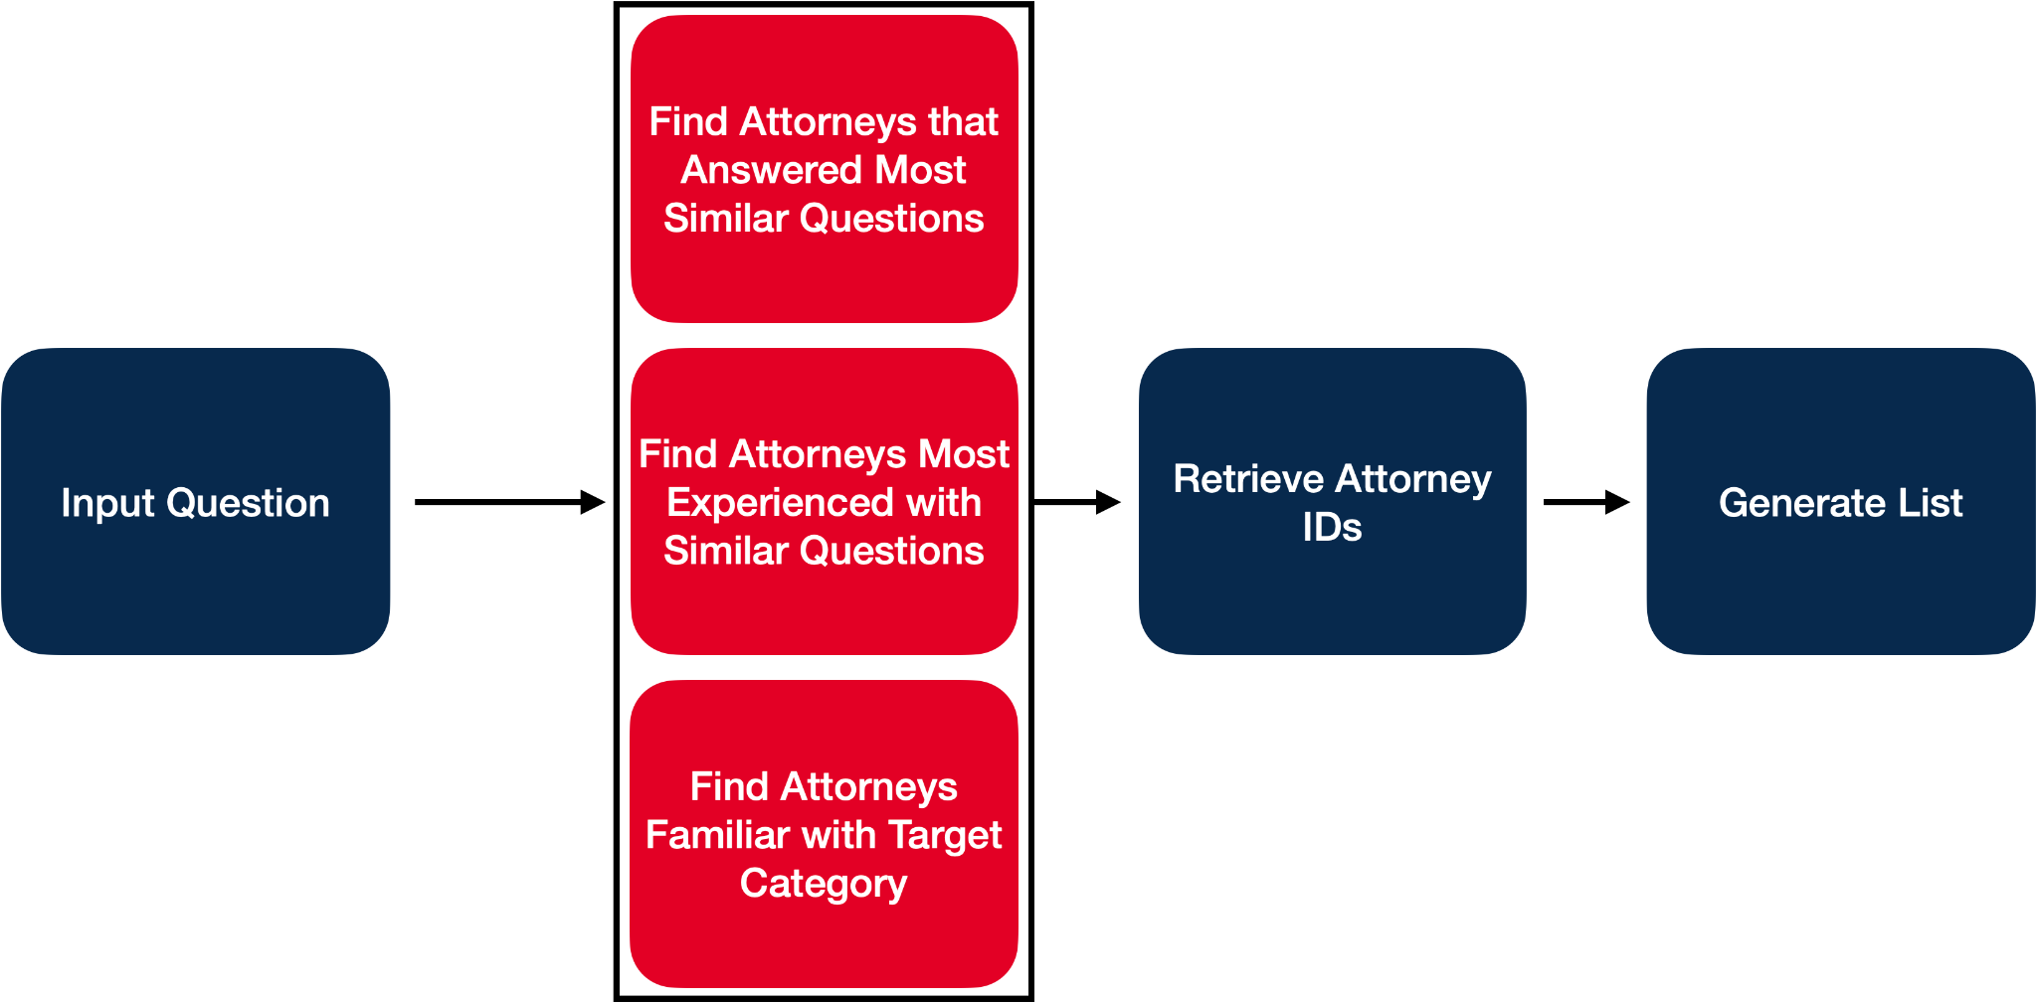
Recommendation System Approach

Slide 6
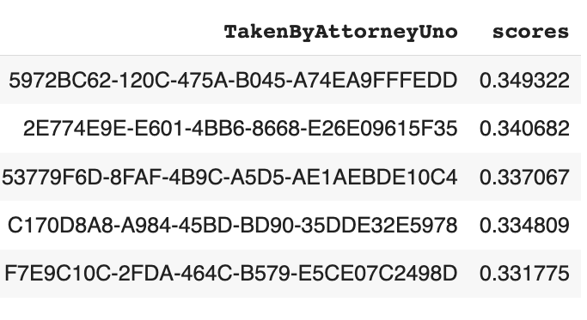
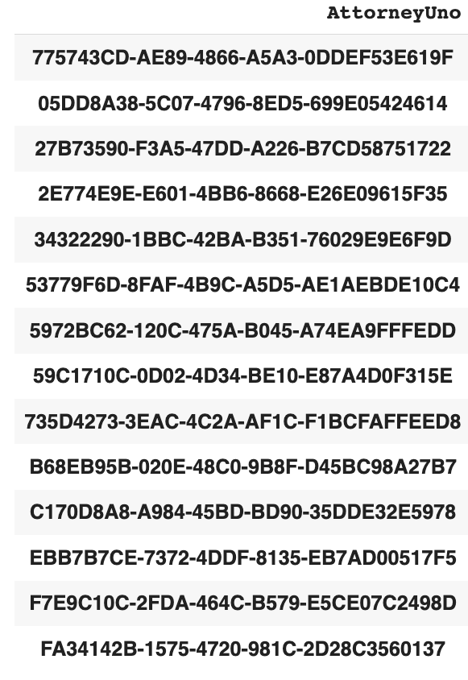
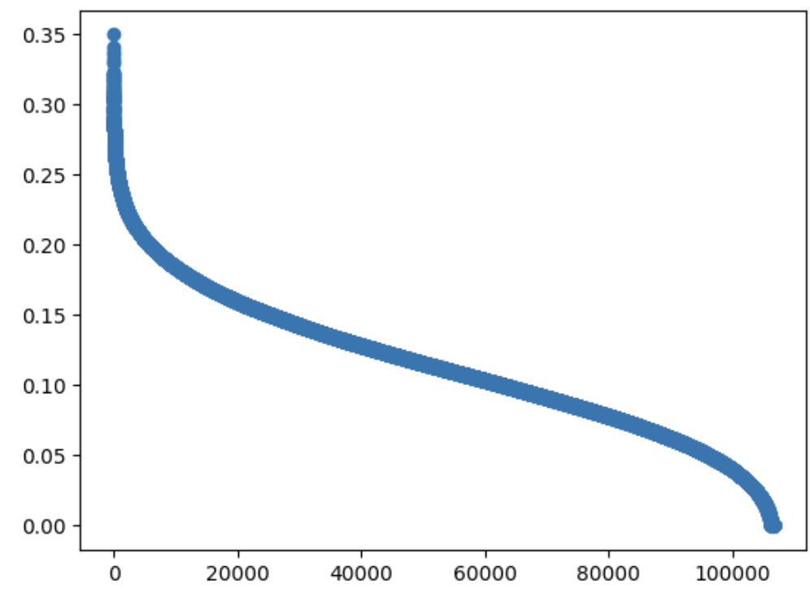
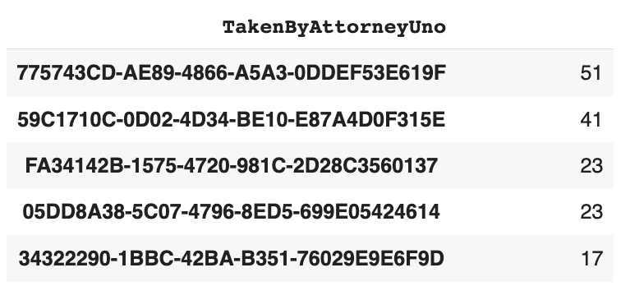
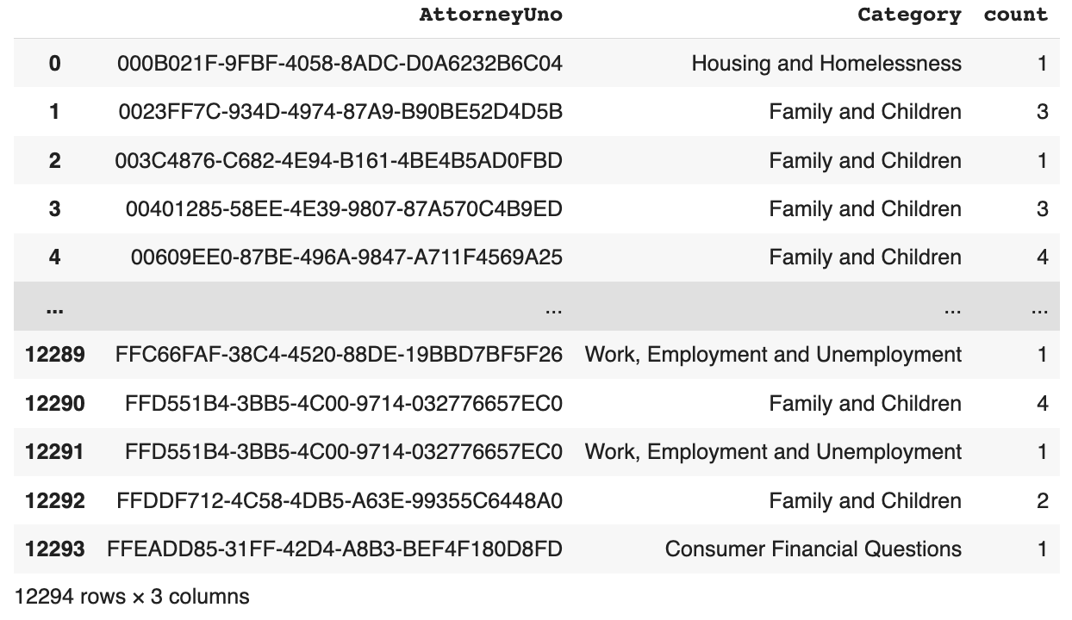
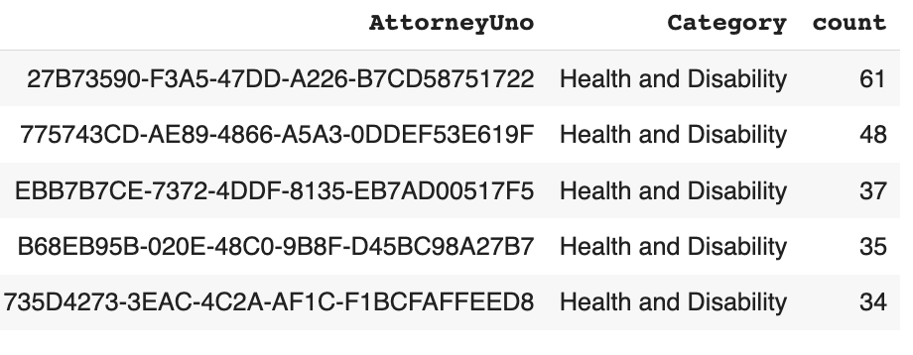
“I applied for a loan modification was told that the underwriter approved and it went off to the ### for final sign off. When calling I asked if they knew what the new terms were and they said no not really but it looked like they were going to ask for a down payment amt of maybe $### ###…”

Slide 7
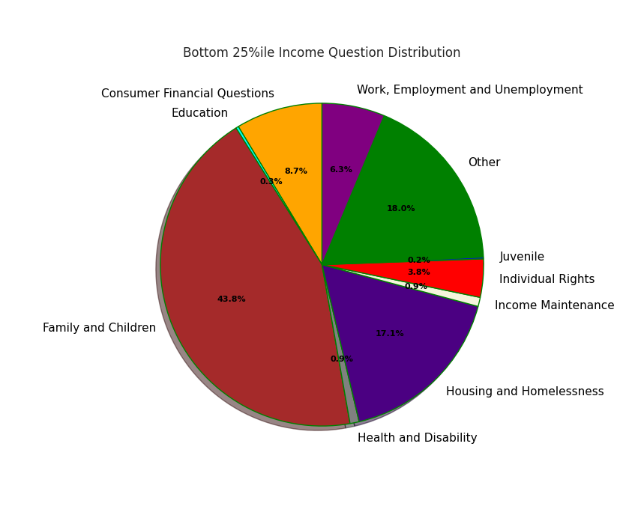
What About the Attorneys?
3 Models were implemented to predict question category based on demographic data
Logistic Regression (Score: 0.471)
Support Vector Machine (Score: 0.473)
Random Forests (Score: 0.447)
Additionally we utilized feature importance to detect which factors were most important and build graphics for our models
Annual Income and Investments Balance were determined to be the most important

Slide 8
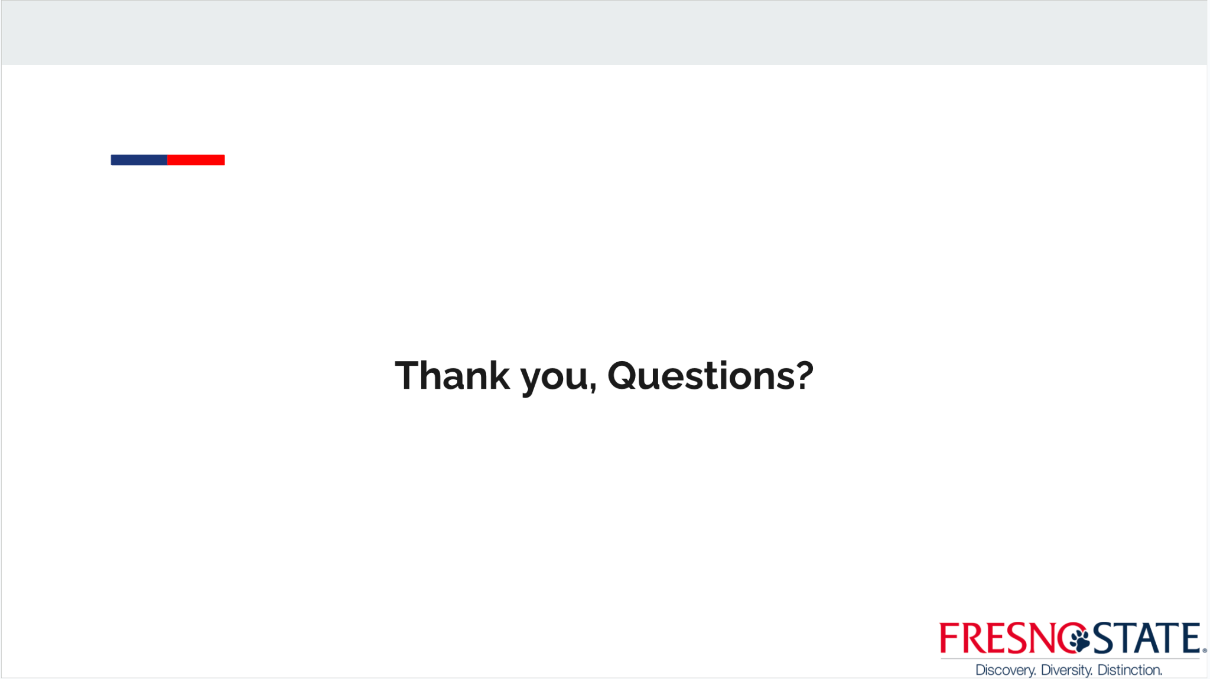
What About the Attorneys?
3 Models were implemented to predict question category based on demographic data
Logistic Regression (Score: 0.471)
Support Vector Machine (Score: 0.473)
Random Forests (Score: 0.447)
Additionally we utilized feature importance to detect which factors were most important and build graphics for our models
Annual Income and Investments Balance were determined to be the most important

